Slide 1
Conditional Statements
By: Nida Munawar

Slide 2
We will learn:
Introduction to conditional statements
If structure
If –else structure
Ternary operator
If-else-if structure
Nested If structure
Switch statements

Slide 3
Introduction to conditional statements
Conditional statements help you to make a decision based on certain conditions.
These conditions are specified by a set of conditional statements having boolean expressions which are evaluated to a boolean value true or false.

Slide 4

If structure
The single if statement in C language is used to execute the code if a condition is true.
It is also called one-way selection statement.
Without using block {} only first statement is considered as if-block statement
Syntax:

Slide 5
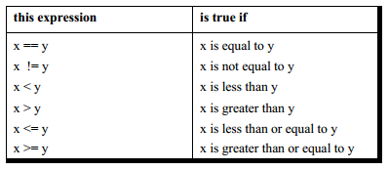
If structure [Cont.]
As a general rule, we express a condition using C’s ‘relational’ operators. The relational operators allow us to compare two values to see whether they are equal to each other, unequal, or whether one is greater than the other. Here’s how they look and how they are evaluated in C.

Slide 6
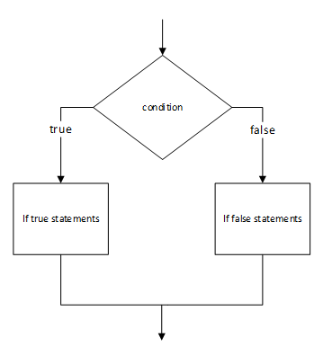
If structure [Cont.]
Flowchart

Slide 7
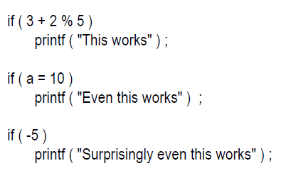
The Real Thing

Slide 8
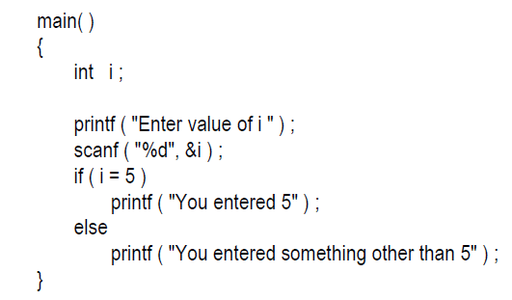
What is the Output of this program?

Slide 9
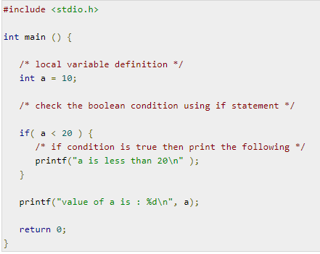
If structure [Cont.]
Example:

Slide 10
If structure [Cont.]
TASK:
While purchasing certain items, a discount of 10% is offered if the quantity purchased is more than 1000. If quantity and price per item are input through the keyboard, write a program to calculate the total expenses.

Slide 11
If structure [Cont.]
/* Calculation of total expenses*/
main( )
{
int qty, dis = 0 ;
float rate, tot ;
printf ( "Enter quantity and rate" ) ;
scanf ( "%d %f", &qty, &rate) ;
if ( qty > 1000 )
dis = 10 ;
tot = ( qty * rate ) - ( qty * rate * dis / 100 ) ;
printf ( "Total expenses = Rs. %f", tot ) ;
}

Slide 12
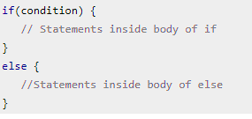
If else structure
The decision logic structure uses the If/Then/Else instruction. It tells the computer that if a condition is true, then execute a set of instructions, or Else execute another set of instructions.
The Else part is optional, as there is not always a set of instructions if the conditions are false.
Syntax:

Slide 13
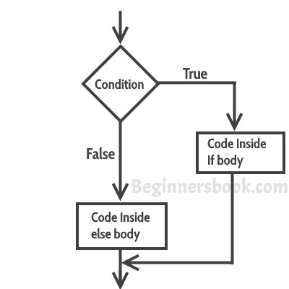
If else structure [Cont.]

Slide 14
If else structure [Cont.]
Example:
Write a program in which user is asked to enter the age and based on the input, the if..else statement checks whether the entered age is greater than or equal to 18. If this condition meet then display message “You are eligible for voting”, however if the condition doesn’t meet then display a different message “You are not eligible for voting”.

Slide 15
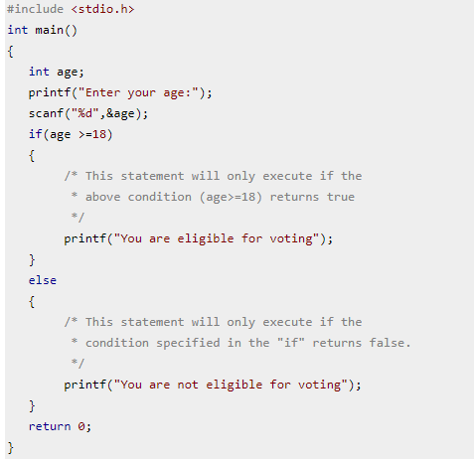
If else structure [Cont.]

Slide 16
If else structure [Cont.]
TASK:
If his basic salary is less than Rs. 1500, then Allowance = 10% of basic salary and House Rent Allowance= 90% of basic salary.
If his salary is either equal to or above Rs. 1500, then
Allowance = 500 and House Rent Allowance= 98% of basic salary.
If the employee's salary is input through the keyboard write
a program to find his gross salary and also design flowchart.

Slide 17
If else structure [Cont.]
/* Calculation of gross salary */
main( )
{
float bs, gs, al, hra ;
printf ( "Enter basic salary " ) ;
scanf ( "%f", &bs ) ;
if ( bs < 1500 )
{
al = bs * 10 / 100 ;
hra = bs * 90 / 100 ;
}
else
{
al = 500 ;
hra = bs * 98 / 100 ;
}
gs = bs + hra + al ;
printf ( "gross salary = Rs. %f", gs ) ;
}

Slide 18
The ? Operator/Conditional Operator
The ? (ternary condition) operator is a more efficient form for expressing simple if statements. It has the following form:
expression1 ? expression2: expression3
It simply states:
if expression1 then expression2 else expression3
It can be visualized into if-else statement as:
if(Expression1) {
Expression2;
} else {
Expression3; }

Slide 19
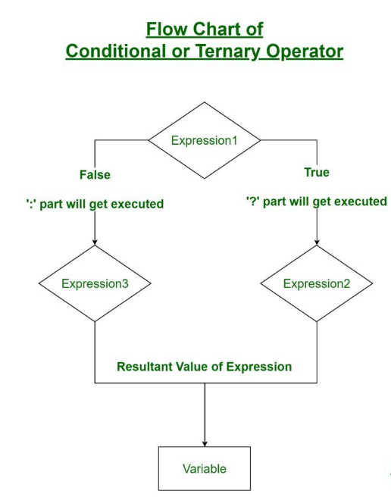
The ? Operator

Slide 20
The ? Operator
For example to assign the maximum of a and b to z:
z = (a>b) ? a : b;
which is the same as:
if (a>b)
z = a;
else
z=b;
Another Example
int i ;
scanf ( "%d", &i ) ;
( i == 1 ? printf ( “Hello" ) : printf ( “Bye" ) ) ;

Slide 21
Task
Write a program to Store the greatest of the two Number.

Slide 22
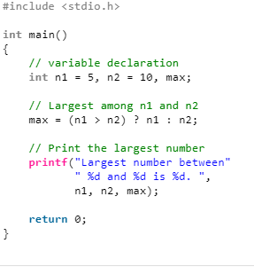

Slide 23
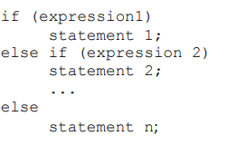
If else if structure
Multiple conditions can be written by making several else-if clauses. Once a condition is true, control will never go to other else-if conditions. An else clause can be added after else if statements.
Syntax:

Slide 24
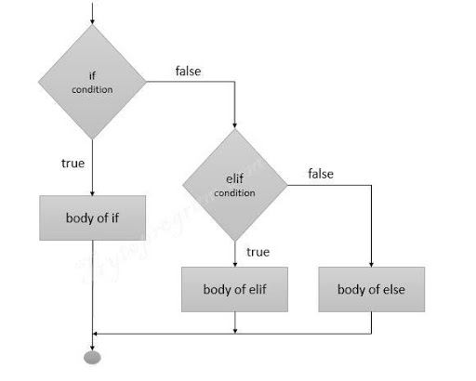
If else if structure [Cont.]

Slide 25
If else if structure [Cont.]
Example: Variable comparisons
#include <stdio.h>
int main()
{
int var1, var2;
printf("Input the value of var1:");
scanf("%d", &var1);
printf("Input the value of var2:");
scanf("%d",&var2);
if (var1 == var2)
{
printf("var1 is equal to var2\n");
}
else if (var1 > var2)
{
printf("var1 is greater than var2\n");
}
else if (var2 > var1)
{
printf("var2 is greater than var1\n");
}
else
{
printf(“error\n");
}
return 0;
}

Slide 26
If else if structure [Cont.]
TASK:
The marks obtained by a student in 5 different subjects are input through the keyboard. The student gets a division as per the following rules:
Percentage above or equal to 60 - First division
Percentage between 50 and 59 - Second division
Percentage between 40 and 49 - Third division
Percentage less than 40 - Fail
Write a program to calculate the division obtained by the student and also draw flowchart.

Slide 27
If else if structure [Cont.]
main( )
{
int m1, m2, m3, m4, m5, per ;
printf ( "Enter marks in five subjects " ) ;
scanf ( "%d %d %d %d %d", &m1, &m2, &m3, &m4, &m5 ) ;
per = ( m1 + m2 + m3 + m4 + m5 ) / 5 ;
if ( per >= 60 )
{
printf ( "First division ") ;
}

Slide 28
If else if structure [Cont.]
else if ( per >= 50 )
{
printf ( "Second division" ) ;
}
else if ( per >= 40 )
{
printf ( "Third division" ) ;
}
else
printf ( "Fail" ) ;
}
}
}

Slide 29
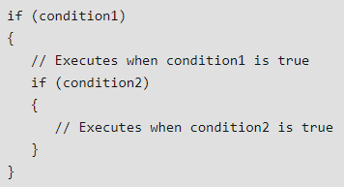
Nested if structure
A nested if in C is an if statement that is the target of another if statement. Nested if statements means an if statement inside another if statement.
Syntax:

Slide 30
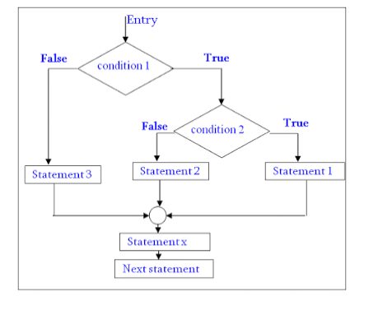
Nested if structure [Cont.]

Slide 31
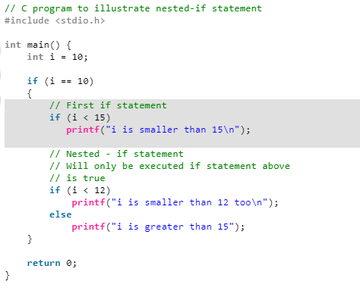
Nested if structure [Cont.]
Example:

Slide 32
Logical Operators
C allows usage of three logical operators, namely, &&, || and !.
These are to be read as ‘AND’ ‘OR’ and ‘NOT’ respectively.
Most obviously, two of them are composed of double symbols: ||and
&&.
The first two operators, &&and ||, allow two or more conditions to be combined in an if statement.
The third logical operator is the NOT operator, written as !.
This operator reverses the result of the expression it operates on. For example, if the expression evaluates to a non-zero value, then applying ! operator to it results into a 0. Vice versa, if the expression evaluates to zero then on applying !operator to it makes it 1, a non-zero value.

Slide 33
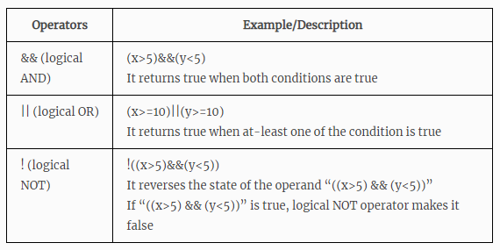
Logical Operators [Cont.]

Slide 34
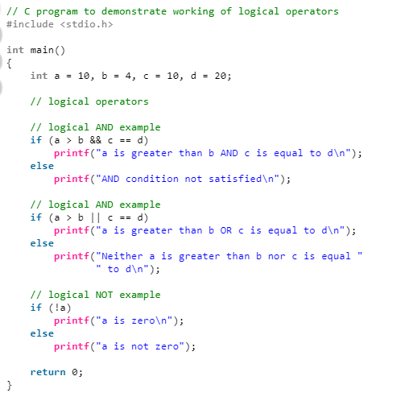
Logical Operators [Cont.]

Slide 35
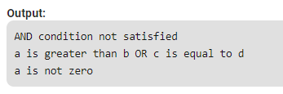
Logical Operators [Cont.]

Slide 36
Logical Operators [Cont.]
TASK:
Write a C program by Using conditional operators to determine:
(1) Whether the character entered through the keyboard is a
lower case alphabet or not.
(2) Whether a character entered through the keyboard is a
special symbol or not.

Slide 37
Switch Case Structure
The switch statement allows us to execute one code block among many alternatives.
You can do the same thing with the if...else..if ladder.
However, the syntax of the switch statement is much easier to read and write.
Each case in a block of a switch has a different name/number which is referred to as an identifier. The value provided by the user is compared with all the cases inside the switch block until the match is found.

Slide 38

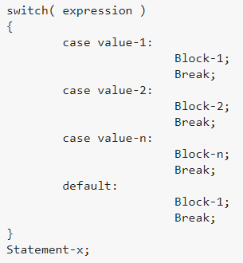
Switch Case Structure [Cont.]

Slide 39
Switch Case Structure [Cont.]
The expression can be integer expression or a character expression.
Value-1, 2, n are case labels which are used to identify each case individually.
Case labels always end with a colon ( : ). Each of these cases is associated with a block.
A block is nothing but multiple statements which are grouped for a particular case.
Whenever the switch is executed, the value of test-expression is compared with all the cases which we have defined inside the switch.

Slide 40
The expression is evaluated once and compared with the values of each case label.
If there is a match, the corresponding statements after the matching label are
executed.
For example, if the value of the expression is equal to constant2,
statements after case constant2: are executed until break is encountered.
If there is no match, the default statements are executed.
If we do not use break, all statements after the matching label are executed.
By the way, the default clause inside the switch statement is optional.

Slide 41
Switch Case Structure [Cont.]
The break keyword in each case indicates the end of a particular case. If we do not put the break in each case then even though the specific case is executed, the switch will continue to execute all the cases until the end is reached. This should not happen; hence we always have to put break keyword in each case. Break will terminate the case once it is executed and the control will fall out of the switch.
The default case is an optional one. Whenever the value of test-expression is not matched with any of the cases inside the switch, then the default will be executed.
Otherwise, it is not necessary to write default in the switch.

Slide 42
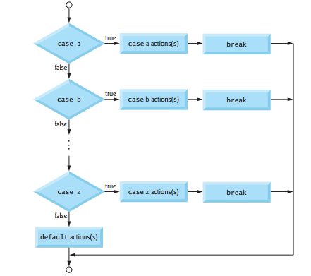
Switch Case Structure [Cont.]

Slide 43
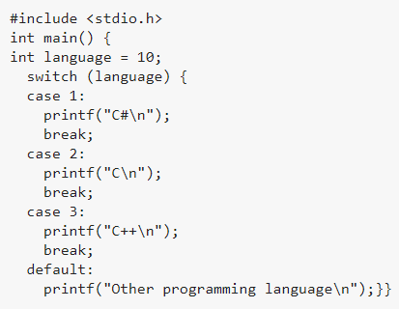
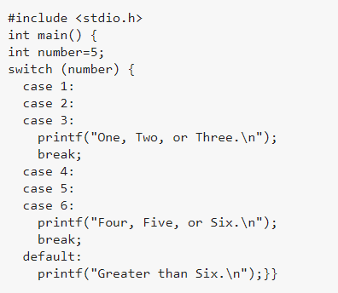
Switch Case Structure [Cont.] Example:

Slide 44
Nested Switch
In C, we can have an inner switch embedded in an outer switch. Also, the case constants of the inner and outer switch may have common values and without any conflicts.

Slide 45
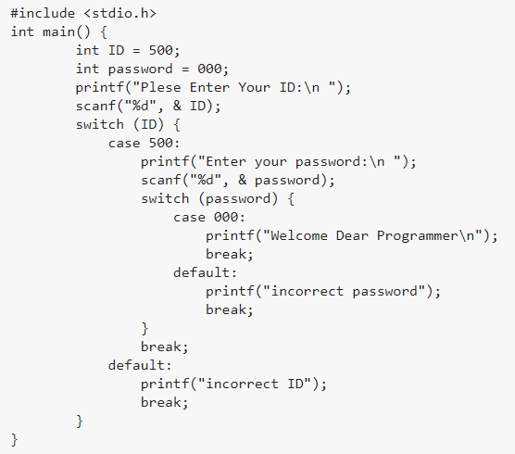
Nested Switch [Cont.]

Slide 46
Nested Switch
Why do we need a Switch case?
There is one potential problem with the if-else statement which is the complexity of the program increases whenever the number of alternative path increases. If you use multiple if-else constructs in the program, a program might become difficult to read and comprehend.
Sometimes it may even confuse the developer who himself wrote the program.
The solution to this problem is the switch statement.

Slide 47
TASK:
Write a C program to print number of days in a month when user inputs the number of month using switch condition.

Slide 48
